Slide 1
Unitarian Universalist Society of Sacramento
150th Anniversary, 2018
Prepared by Sandra S. Navarro

Slide 2
First Unitarian Church of Sacramento
1858: First known Unitarian sermon in Sacramento, California
1860: Rev. Thomas Starr King gives two lectures in city
1868: First Unitarian Church established

Slide 3
Cookbook published in 1890
“Approved by the Ladies of the Unitarian Society”
Currently archived in the California State Library

Slide 4
Sacramento Unitarian Society, 1922
Rev. Berkley Blake and wife, front row right

Slide 5
Rev. Robert Withington, First Unitarian, Sacramento
1932

Slide 6
First Unitarian Church of Sacramento
27th Street, between N and O; built in 1915

Slide 7
First Unitarian Society of Sacramento
Interior, 1415 27th Street

Slide 8
First Unitarian Church of Sacramento
Unitarian Society Bookshop, 1950s

Slide 9
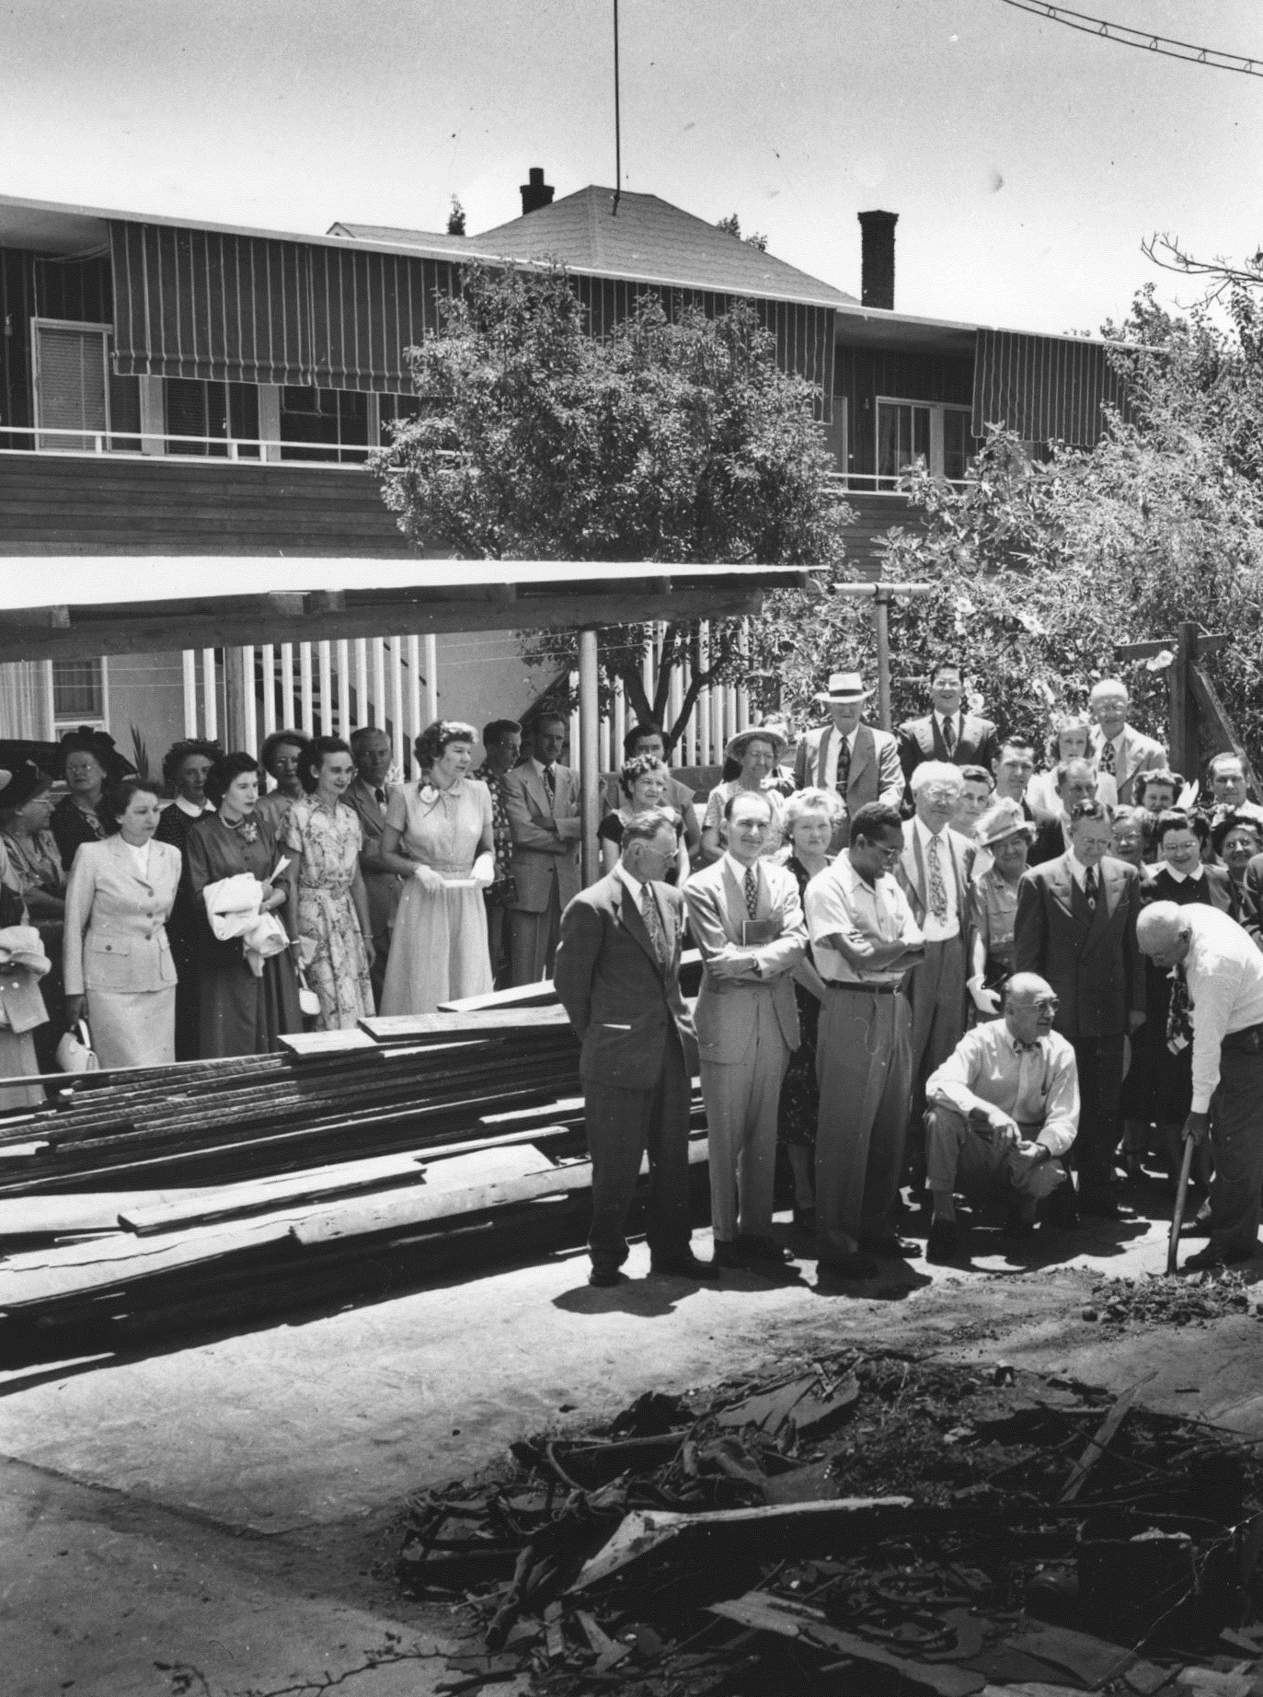
June 18, 1950
Dedication of annex to Sunday School cottage, at 1415 27th Street church

Slide 10
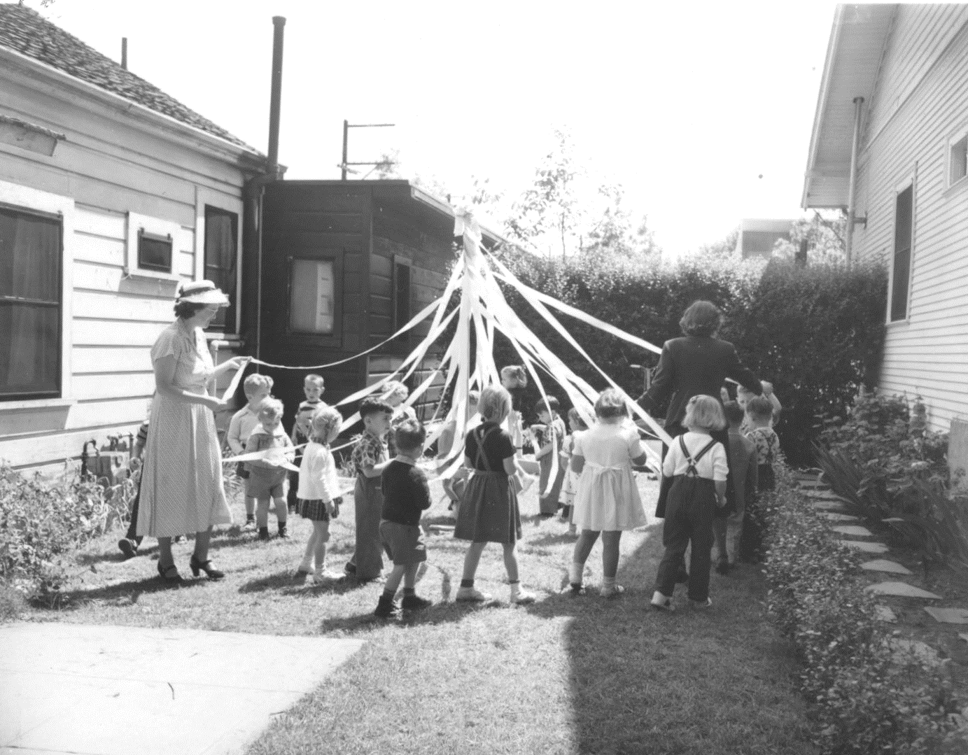
Religious Education
First Unitarian of Sacramento
1415 27th Street
1950s

Slide 11
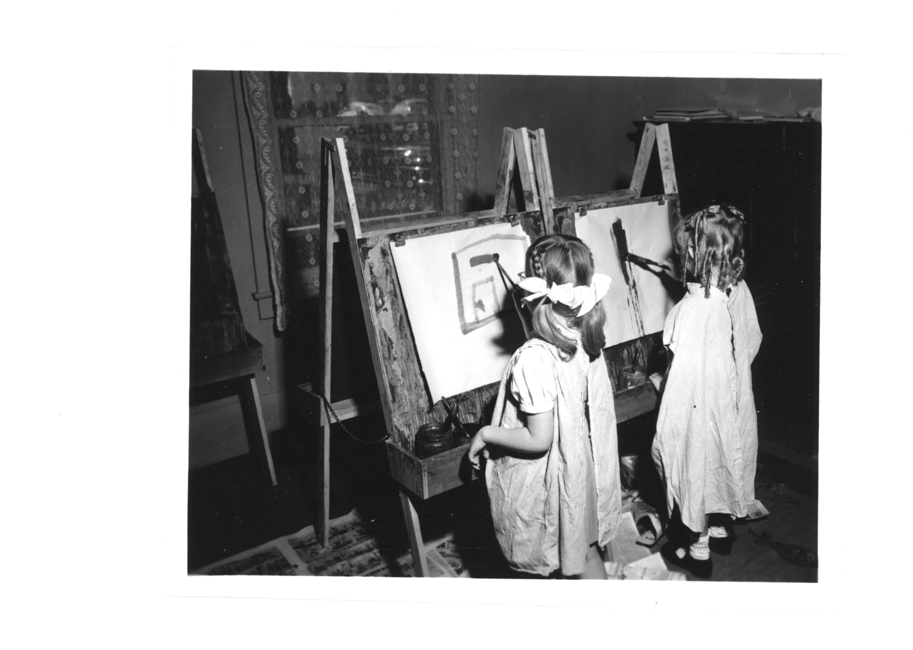
Religious Education
Preschool class
February 1953

Slide 12
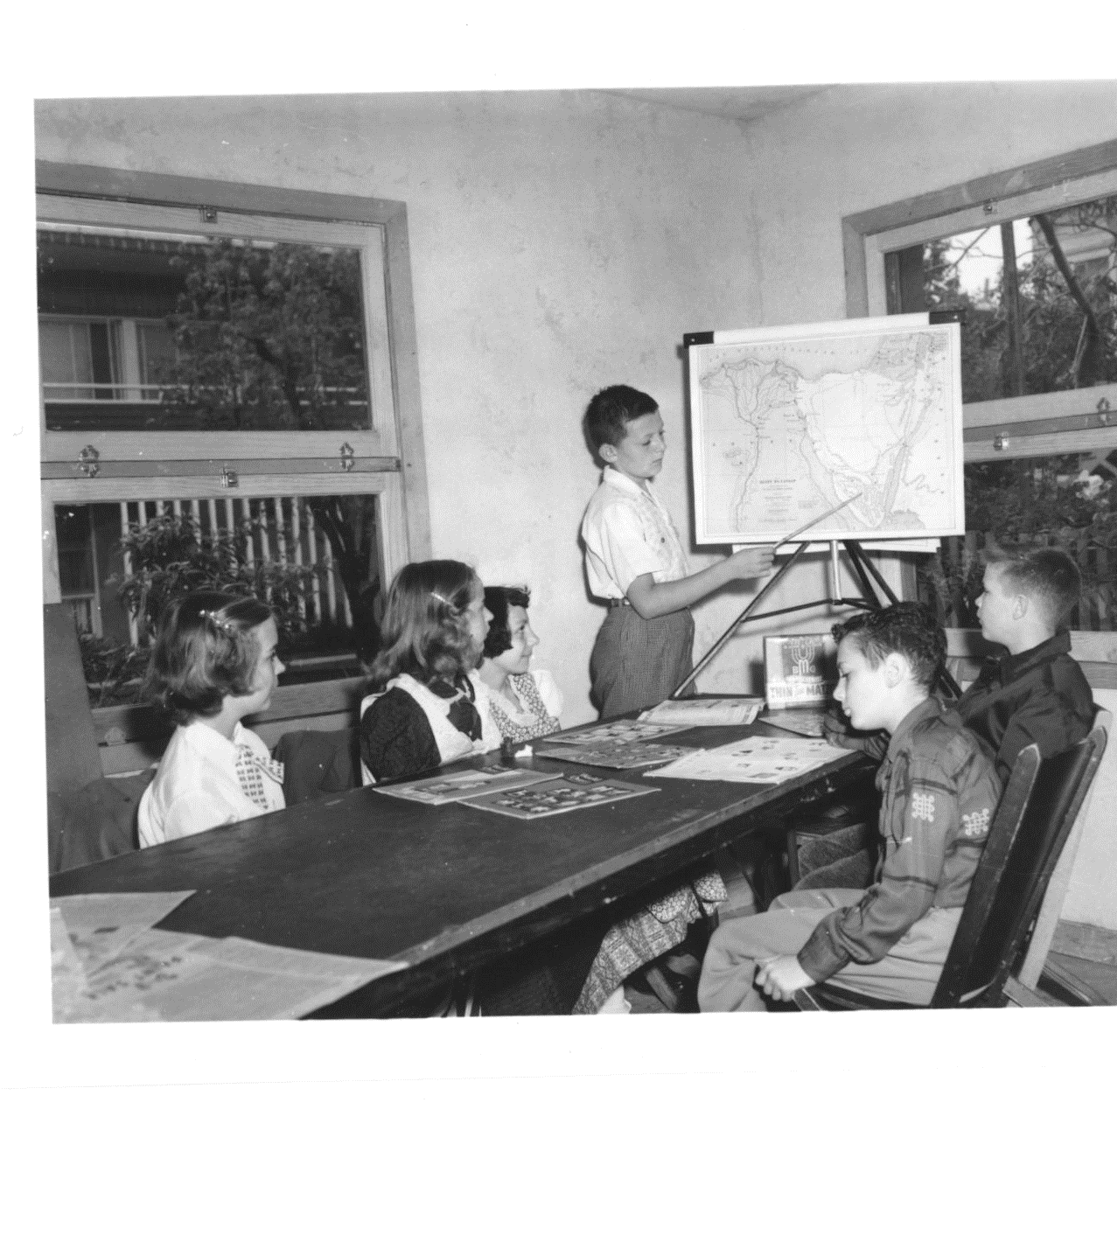
Religious Education
February1953

Slide 13
Sunday School
Religious education
1415 27th St., Sacramento
1955

Slide 14
Church Building Drive
Victory meeting
1958

Slide 15
Church Master Plan
John Harvey Carter, architect
2425 Sierra Boulevard
1958

Slide 16
Site of UUSS
Seen from Sierra Blvd.
Looking northwest
1958

Slide 17
Unitarian Society of Sacramento
Groundbreaking on Sierra Blvd., August 1959

Slide 18
Unitarian Society of Sacramento
Groundbreaking
2425 Sierra Boulevard
August 1959

Slide 19
Unitarian Society of Sacramento
Groundbreaking
2425 Sierra Boulevard
August 1959

Slide 20
Construction at 2425 Sierra Boulevard, Sacramento,1959-1960

Slide 21
Unitarian Society of Sacramento
Building on Sierra Blvd.
1959-1960

Slide 22
Unitarian Society of Sacramento
Construction
2425 Sierra Blvd.
1959-1960

Slide 23
Unitarian Society of Sacramento
Building on Sierra Blvd., 1959-1960

Slide 24
Unitarian Society of Sacramento
Building on Sierra Blvd., 1959-1960

Slide 25
Unitarian Society of Sacramento
Building on Sierra Blvd., 1959-1960

Slide 26
First Unitarian Society, Sacramento, California
Harvest Dinner, Fall 1961

Slide 27
United Nations Day,1962
Unitarian Society of Sacramento

Slide 28
Welcome Table, 1960s
Unitarian Society
of Sacramento

Slide 29
UUSS and Congregation B’nai Israel
Annual Interfaith Dinner
Congregation B’nai Israel’s production of Joseph and the Amazing Technicolor Dreamcoat
1973

Slide 30
UUSS
Sunday Service
2425 Sierra Boulevard
1981

Slide 31
Peace Fair, 1981

Slide 32
UUSS Fifty-Year Members
1998

Slide 33
UUSS Fifty-Year Members
1998

Slide 34
Unitarian Universalist Society of Sacramento
Some past presidents
July 2005

Slide 35
Unitarian Universalist Society of Sacramento
Renovation dedicated in 2014

